Slide 1
Plenary Session 2
Statistics for Clinical Trials:
Basics of a Phase III Trial
Design and Interpretation
Wei Tu PhD
Senior Biostatistician, CCTG; Assistant Professor, Queen’s University
CCTG New Investigator Clinical Trials Course, Aug 21st, 2024.
Kingston, ON

Slide 2
Phase III trial
A phase III trial typically involves a direct comparison of a new treatment and standard of care in terms of efficacy, safety, quality of life, etc.
Statistically, we are doing a hypothesis testing and/or estimation.
When quantifying the performance of an estimation, we can use mean squared error (MSE)
$$MSE=E\left[{\left(\hat{θ} −θ\right)}^{2}\right]=Bias^{2}\left(\hat{θ}, θ\right)+Var(\hat{θ})$$
Our two enemies here: Bias and Variation.

Slide 3
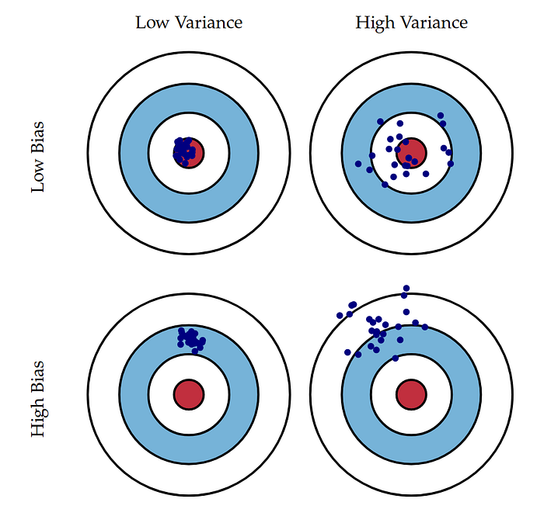
Bias and Variation
https://towardsdatascience.com/bias-and-variance-in-linear-models-e772546e0c30

Slide 4
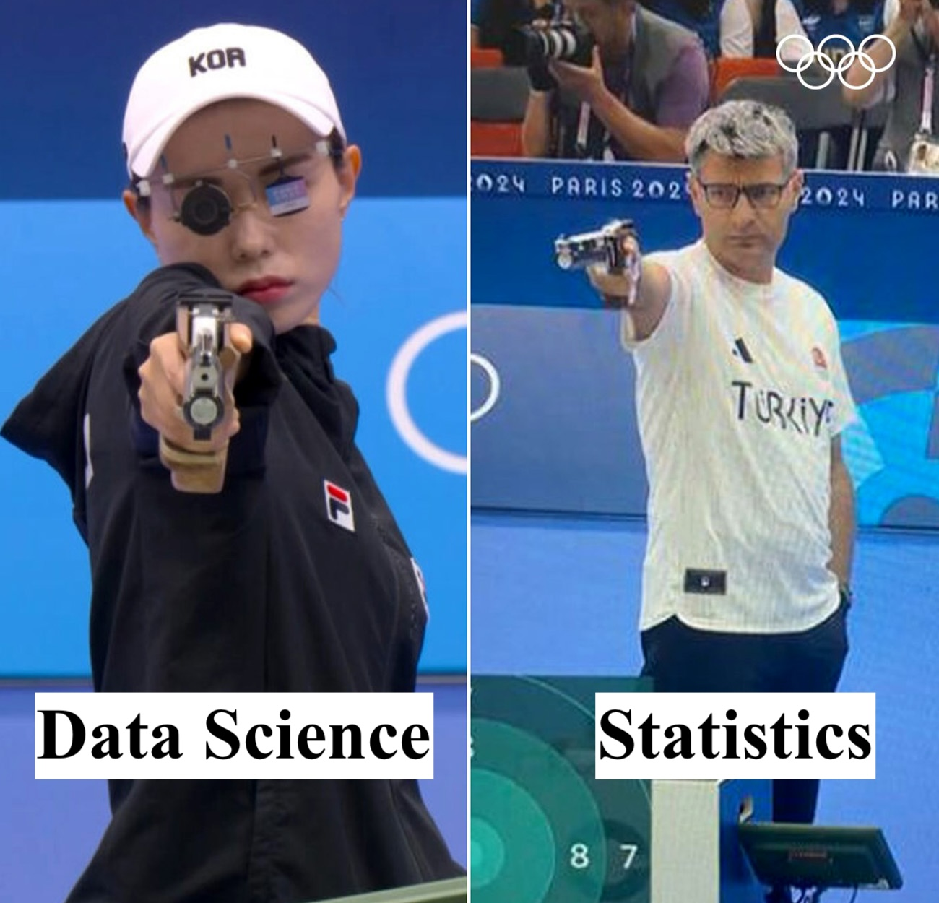
Bias and Variation
You have got ONE shot!
https://towardsdatascience.com/bias-and-variance-in-linear-models-e772546e0c30
Adapted from https://www.outdoorlife.com/wp-content/uploads/2024/08/olympics_turkish_shooter_internet_legend_2.jpg

Slide 5
Strategies to reduce bias
Stratification
Blinding
Randomization
Intention to Treat

Slide 6
Strategies to reduce bias: randomization
Stratification
Blinding
Randomization
Intention to Treat

Slide 7
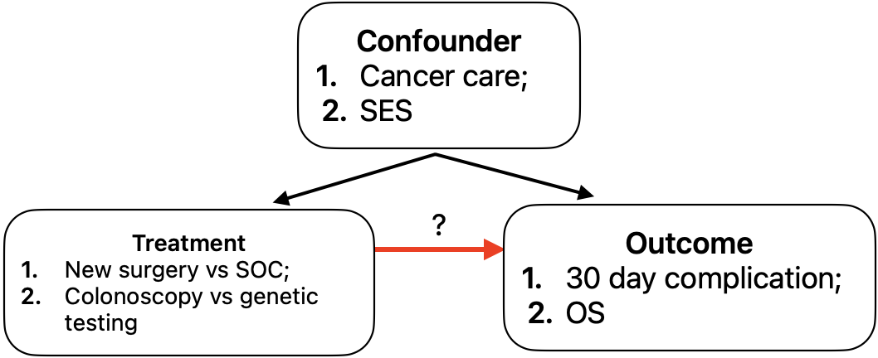
Randomization: why?
Remove confounding: confounding occurs when an outside factor affects both treatment and outcome, potentially leading to a false association between the treatment and outcome.
Selection bias
Allocation bias
Methods such as propensity score matching can eliminate some confounding but does not completely solve it, e.g. unmeasured confounding.

Slide 8
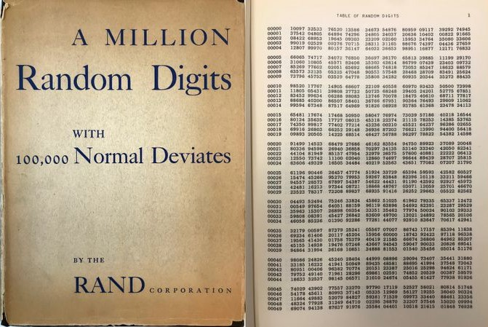
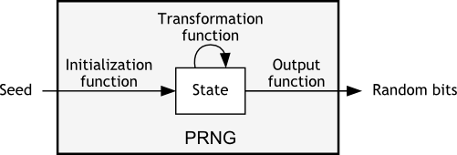
Randomization: how?
Roman 12mm dice, 24th century B.C. tomb. The Portable Antiquities Scheme/Trustees of the British Museum (CC BY-SA 2.0)
RAND corporation, 1950s. Numbers generated from random pulses by a gas-discharge voltage-regulator tube.
Schematic diagram of a pseudo-random number generator (PRNG)
https://pit-claudel.fr/clement/blog/how-random-is-pseudo-random-testing-pseudo-random-number-generators-and-measuring-randomness/

Slide 9
Randomization: different techniques
Technique | Pros | Cons
Simple randomization | Simple | Might not balance confounders in smaller trials
Block randomization | Simple, easy to implement | Risk of predictability
Stratified randomization | Ensure key prognostic factors are balanced | More complex to implement and require knowledge of strat factors
Minimization/Dynamic randomization/Covariate Adaptive | Maximally ensure key prognostic factors are balanced, even in small trials | More complex to implement; less transparent; risk of predictability
Cluster randomization | Useful when treatments are naturally assigned to groups or when individual randomization is impractical | Require large sample sizes and more complex statistical analyses

Slide 10
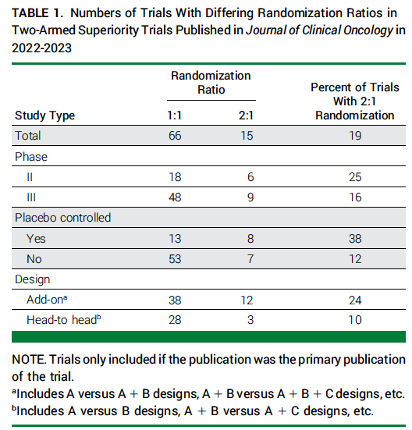
Randomization ratio: 1:1 or 2:1
1:1 randomization is the most efficient statistically. Sample size increase with 2:1. Magnitude of increase depends on design; rule of thumb is about 10-20%.
Key rationale for 2:1 is that it might be appealing to patients, thus accrual rates might be higher.
However, one needs to balance whether the assumed higher accrual rates might result in a shorter trial considering sample size increase, especially in time-to-event endpoints since number of events drives power.
2:1 provides more data in experimental arm, might be appropriate when need enough patients in different biomarker subgroups.
2:1 might suggest SOC arm is inferior, hence may result in more drop out or nonadherence.
Freidlin, Boris, and Edward L. Korn. "Two-to-One Randomization: Rarely Advisable." JCO Oncology Practice (2024): OP-24.

Slide 11
Systematic review of randomization techniques
330 RCTs published in BMJ, JAMA, NEJM, the Lancet in 2019. Include not just oncology trials.
Block stratified randomization was the most used (49%) technique.
Stratification and minimization seems to be used in larger multicenter trials.
Bruce, Cydney L., et al. "A systematic review of randomisation method use in RCTs and association of trial design characteristics with method selection." BMC Medical Research Methodology 22.1 (2022): 314.

Slide 12
Strategies to reduce bias: stratification
Stratification
Blinding
Randomization
Intention to Treat

Slide 13
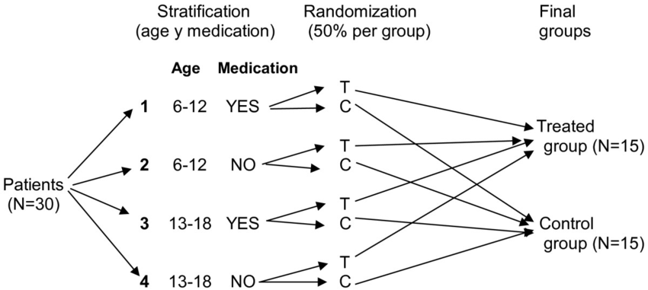
Stratification
Stratification can (slightly) improve statistical power when factors strongly affect endpoint and there exists large treatment effect (by reducing variability);
Stratification is probability unnecessary for larger trials;
Stratification factors needs to be accounted for in trial analysis. (P-value overestimates if not).
Keep the number of strata small!
Balance key prognostic factors, especially in smaller trials;
Enable subgroup analysis;
Results in more data collection burden.

Slide 14
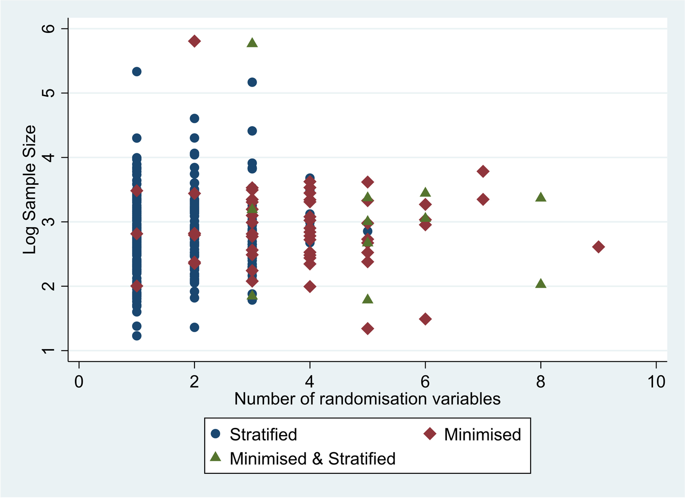
Systematic review of stratification
Usually, 2-4 stratification factors are used.
Minimization can accommodate a larger number of stratification factors.
Stratification and minimization seems to be used in larger multicenter trials.
CCTG P3 trial standard is minimization.
Bruce, Cydney L., et al. "A systematic review of randomisation method use in RCTs and association of trial design characteristics with method selection." BMC Medical Research Methodology 22.1 (2022): 314.

Slide 15
Strategies to reduce bias: blinding
Stratification
Blinding
Randomization
Intention to Treat

Slide 16
Blinding
Blinding is a process in a trial where one or more parties do not know which treatment participants are receiving.
A trial can be unblinded, single-blind (patients), double-blind (patients, investigators).
Blinding can reduce performance and detection bias (patients or investigators behave and/or assess differently depending on treatment), attrition bias (patients drop out differently depending on treatment).

Slide 17
Strategies to reduce bias
Stratification
Blinding
Randomization
Intention to Treat

Slide 18
Intention to treat (ITT)
Principle | Definition | Characteristics
Intention to treat (ITT) | ITT analysis includes all participants in the groups to which they were originally assigned, regardless of whether they completed the intervention as per the protocol. | Pros: Preserves randomization and reduce confounding. Cons: non-compliant participants may dilute observed treatment effect. Missing data.
Per-protocol (PP) | PP analysis includes only those participants who completed the treatment according to the study protocol. It excludes participants who deviated from the protocol. | Pros: provides a clear picture of treatment efficacy and toxicity among those who fully adhere to the protocol. Cons: introduce potential selection bias, especially when protocol deviation is related to outcome.
As treated (AT) | AT analysis groups participants based on the treatment they actually received, regardless of the initial randomization | Pros: provides a clear picture of treatment efficacy and toxicity based on treatment actually received. Cons: introduce potential selection bias, especially when crossover is related to outcome.

Slide 19
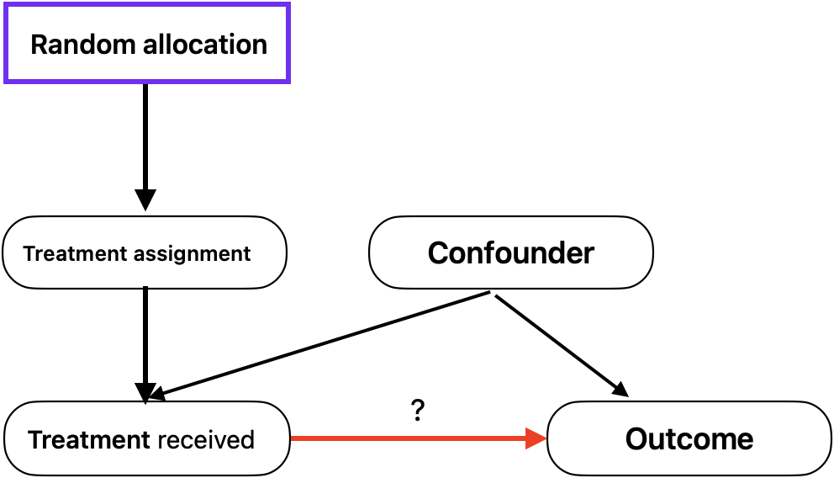
Intention to treat (ITT)
ITT is generally preferred for primary analysis since it maintains the integrity of the randomization process, provides a more conservative and real-world estimate of treatment effect. PP and AT analyses can be used as sensitivity analysis.
When randomized to SOC arm, sick patients might be more likely to drop out and enroll into another trial, PP and AT analyses thus introduces confounding.

Slide 20
Strategies to reduce variation
Patient selection: homogeneous population minimizes variability in treatment effects, making it easier to detect differences. However, it’s essential to balance this with inclusivity to ensure the study population appropriately represents the broader patient population.
Appropriate sample size: an adequately sized sample ensures the study has enough power to detect a clinically meaningful difference between treatment groups.
Clear presentation of your
sample size derivation.

Slide 21
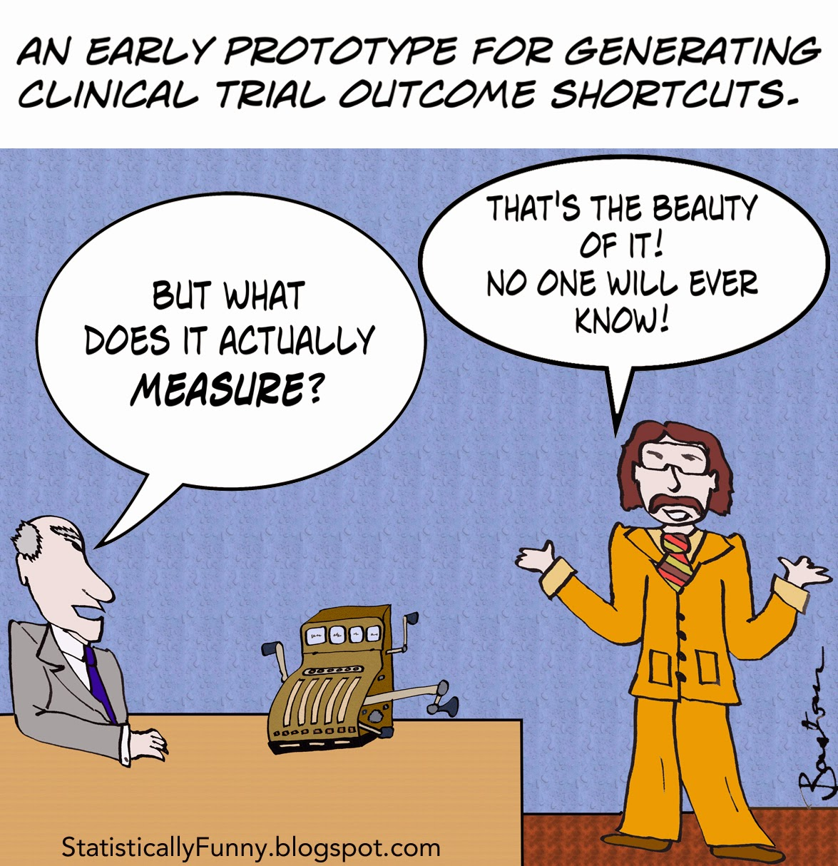
More Statistics: things you should know as trialists
https://statistically-funny.blogspot.com/2015/

Slide 22
Superiority vs non-inferiority
Feature | Superiority trial | Non-inferiority trial
Objective | To demonstrate that a new treatment is better than SOC. | To show that a new treatment is not worse than SOC by a predefined non-inferiority (NI) margin.
Hypotheses | H0: new treatment NOT better than SOC; H1: new treatment better than SOC | H0: new treatment is worse than SOC by more than NI margin; H1: new treatment is NOT worse than SOC by more than NI margin
Context | Used when there is a strong belief that the new treatment may offer better outcomes. | Used when a new treatment may have similar efficacy but offers other advantages (e.g., safety, convenience, cost).
Target difference | Target effect size should reflect clinically meaningful difference. | The NI margin should reflect a difference that would be considered clinically insignificant.

Slide 23
Multiplicity
Multiplicity refers to the potential inflation of the type I error rate because of multiple testing, e.g., multiple subgroups, endpoints, time points, arms.
If we have 5 independent null hypotheses, each tested simultaneously at $α=5\%$. Probability of obtaining at least one positive result is 23% when indeed there is no effect.
If trial has more than 2 arms, multiplicity adjustments are needed to avoid inflation of type I error rate.
A trial typically is only powered for the primary endpoint. If multiple endpoints are important, one can consider a composite endpoint, or hierarchical testing (test OS, if significant, then test PFS; if PFS significant, then test ORR).
If trials include interim analyses (IA) for efficacy, sample size needs to be adjusted for multiple testing (at different time points).

Slide 24
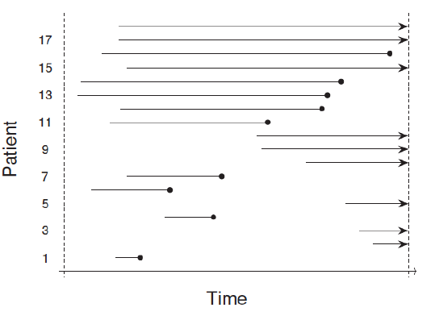
Time to event data, censoring
Time to event data: two parts, event indicator and time variable. Important to clearly define starting and ending time. Examples: OS, PFS, EFS, TTP.
Right censoring: the event time exceeds some observed value, but the exact event time is unknown.
Non-informative censoring: time of censoring contains no information about the distribution of the time to the event.
→: censored time;
---•: uncensored time (event).
Patients enter and end a trial at different times.

Slide 25
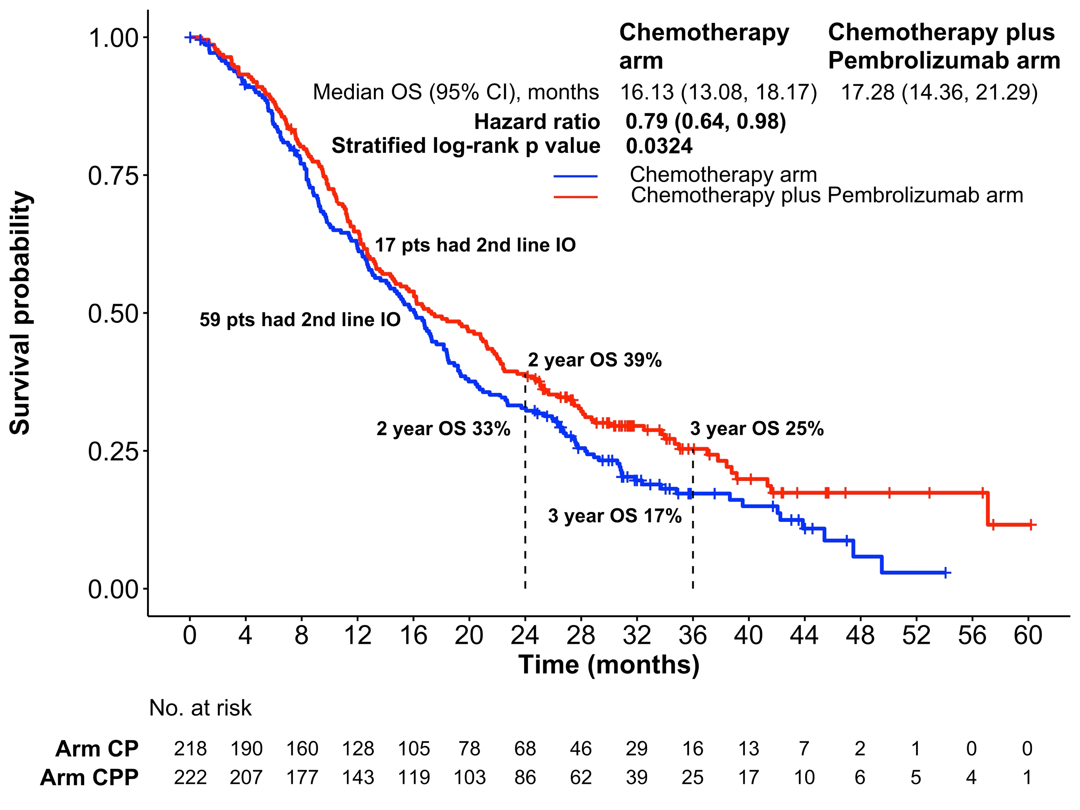
KM curve
KM curve is an estimator for survival function S(t).
KM curve is not smooth, rather step-wise.
Relies on non-informative censoring assumption.
Vertical drops indicate events and ticks indicate censoring. Pay attention to when censoring occurs.
No. at risk: number of patients still at risk of outcome at each time point. Censored patients are NOT considered at risk.
As No. at risk gets smaller, the survival estimator becomes less stable. One patient caused a big drop in arm CPP around month 57.
Chu, Quincy, et al. "Pembrolizumab plus chemotherapy versus chemotherapy in untreated advanced pleural mesothelioma in Canada, Italy, and France: a phase 3, open-label, randomised controlled trial." The Lancet402.10419 (2023): 2295-2306.

Slide 26
Hazard, HR, log-rank test, Cox PH model
Hazard: is like a measure of the "instantaneous risk" of an event (such as death) happening at a particular moment in time, given that the person has survived up until that moment. Hazard changes over time.
Log-rank test: a nonparametric test comparing hazard rates between groups, null hypothesis: $h_{cp}\left(t\right)=h_{cpp}\left(t\right)$. Test is based on noninformative censoring assumption. Log-rank test compares the entire curve rather than specific time point. Power depends on #events, not #patients.
Hazard ratio (HR): an estimate of the ratio of the hazard between new treatment and SOC. Interpretation: CPP reduces the risk of death by 21% comparing with CP. Risk here mean the instantaneous risk of the event at any given point in time, not the chances of obtaining a durable benefit.
Cox proportional hazard (PH) model: often used to provide HR and its CIs. Assumes constant HR over time (can be tested statistically). Can be used to adjust covariates and identify biomarkers.

Slide 27
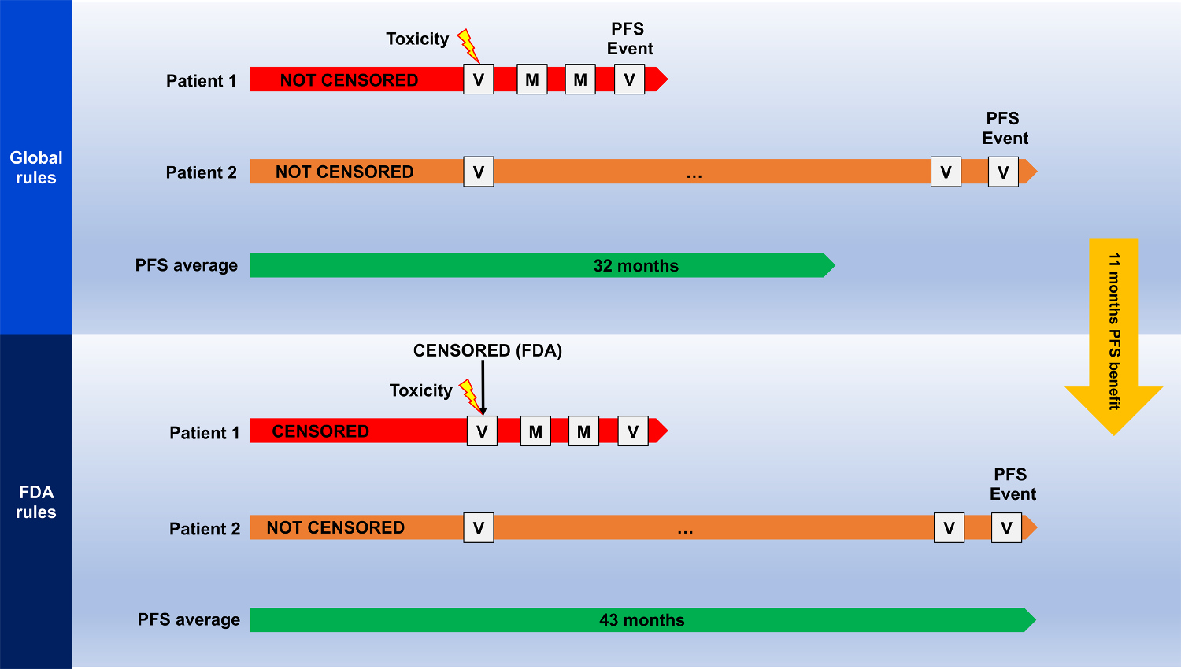
Informative censoring
Informative censoring occurs when censoring contains information about the distribution of event.
Informative censoring introduces bias to almost all survival estimates.
Endpoints such as PFS might be subject to informative censoring.
Important to check number of censoring and reasons between arms.
Sensitivity analysis, competing risk analysis and joint modeling of censoring and event distribution can be useful.
Lesan, Vadim, Timothée Olivier, and Vinay Prasad. "Progression-free survival estimates are shaped by specific censoring rules: Implications for PFS as an endpoint in cancer randomized trials." European Journal of Cancer 202 (2024): 114022.

Slide 28
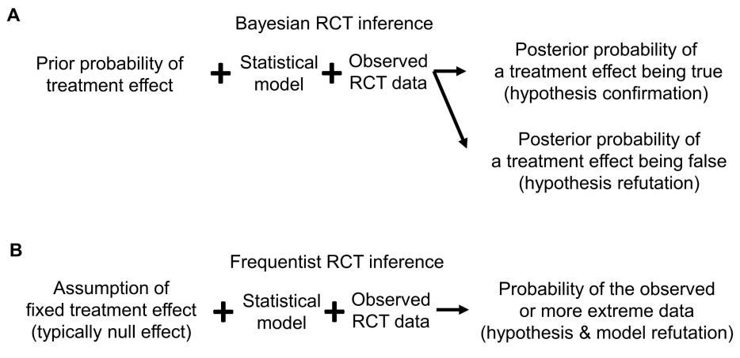
Bayesian vs Frequentist design
Bayesian design incorporate prior information along with the data collected in trial to make decision.
Bayesian design can be more flexible and efficient with high quality prior knowledge.
Bayesian design might add operational challenges (software, expertise).
Communicating a Bayesian design (grant, reviewer, peers) can be challenging and typically relies on simulation.
More Bayesian designs are being used, mostly in early phases.
Msaouel, Pavlos, Juhee Lee, and Peter F. Thall. "Interpreting randomized controlled trials." Cancers 15.19 (2023): 4674.

Slide 29
More Statistics?
FDA Statistical Principles for Clinical Trials https://www.fda.gov/media/71336/download
Journal of Thoracic Oncology: Statistics Series https://www.jto.org/onco-stats
Interpreting Randomized Controlled Trials : https://www.mdpi.com/2072-6694/15/19/4674
Fundamentals of Clinical Trials https://link.springer.com/book/10.1007/978-3-319-18539-2

